Slide 1
Unit-5 part-3

Slide 2
Secure multiparty calculation
One of the techniques which provide the solution to the problems of data security and data privacy is Secure Multiparty Computation.
The secure multiparty computation may be defined as the problem of ‘n’ players to compute jointly on an agreed function securely on the inputs without revealing them.

Slide 3
SFE- Secure Function
The secure multiparty computation is used for the utilization of data without compromising privacy.
It is the cryptographic subfield that helps in preserving the privacy of the data.
Emerging technologies like blockchain, mobile computing, IoT, cloud computing has resulted in the rebirth of secure multiparty computation.
Secure multiparty computation has become the hot area of research in the last decade due to the rise of blockchain technology.

Slide 4
The researchers are now more interested to implement secure multiparty computation in distributed systems.
Unlike in centralized systems, secure multiparty computation may have better performance in distributed systems.

Slide 5
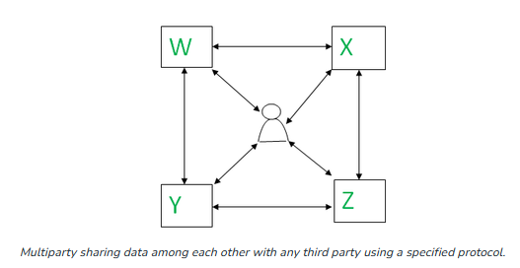
Architecture
The secure multiparty computation provides a protocol where no individual can see the other parties data while distributing the data across multi parties. It enables the data scientists and analysts to compute privately on the distributed data without exposing it.

Slide 6
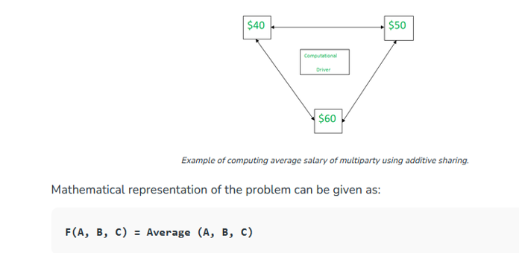
Example
Suppose we want to compute the average salary among three employees without revealing the actual salary, for such problems one can use secure multiparty computation. Let’s take an example-

Slide 7
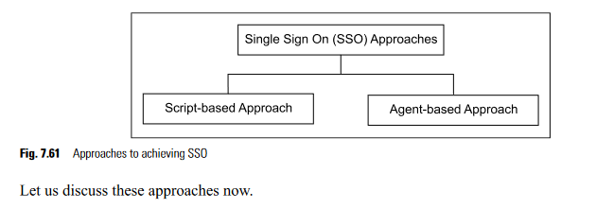
SINGLE SIGN ON (SSO) APPROACHES
Single Sign On (SSO) is an authentication scheme where users can securely authenticate and gain access to multiple applications and websites ...
There are two broad-level approaches to achieving SSO
In the scripting technique, the SSO software mimics user actions. It does this by interpreting a program (the script), which simulates the user-depressing keyboard keys, and reacting to individual end-system sign-on prompts. The SSO product itself holds and manages the different sets of authentication infor- mation required by the end-system

Slide 8
In the agent-based approach, every Web server running an application must have a piece of software, called as an agent. Additionally, there is a single SSO server, which interacts with the user database to validate user credentials

Slide 9


